Slide 1

PSG COLLEGE OF TECHNOLOGY
PSG INDUSTRIAL INSTITUTE
MINI PROJECT

Slide 2
PROJECT TITLE
SMART TRAFFIC AUTOMATION FOR HIGH PRIORITY VEHICLES USING LORA MODULE
SUBMITTED BY
LAKSHMI PRIYADARSHINI R(22E619)
SHAMYUKTHA M(22E634)
SUWETHA J(22E641)
RAM PRASANTH J(23E905)
VIVIN VEERA M(23E909)

Slide 3
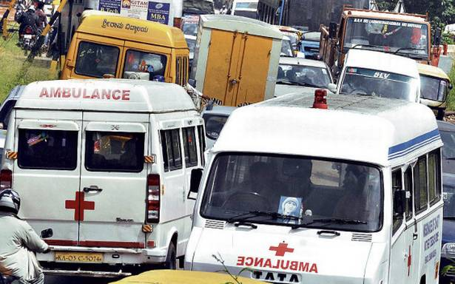
ABSTRACT
The primary objective of this project is to provide efficient routes for high-priority vehicles, allowing them to navigate congested intersections swiftly and without delays.
By implementing LoRa WAN module technology, which offers a range exceeding 10 km, high-priority vehicles can bypass traffic signals, ensuring seamless passage.
This system allows authorities to monitor and track vehicles in real-time, thereby enhancing operational efficiency and reducing delays.
This Photo by Unknown Author is licensed under CC BY-NC

Slide 4
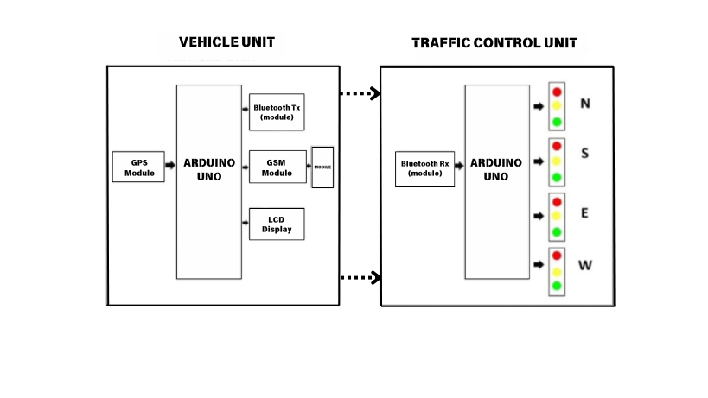
BLOCK DIAGRAM ( Bluetooth module for simulation )

Slide 5
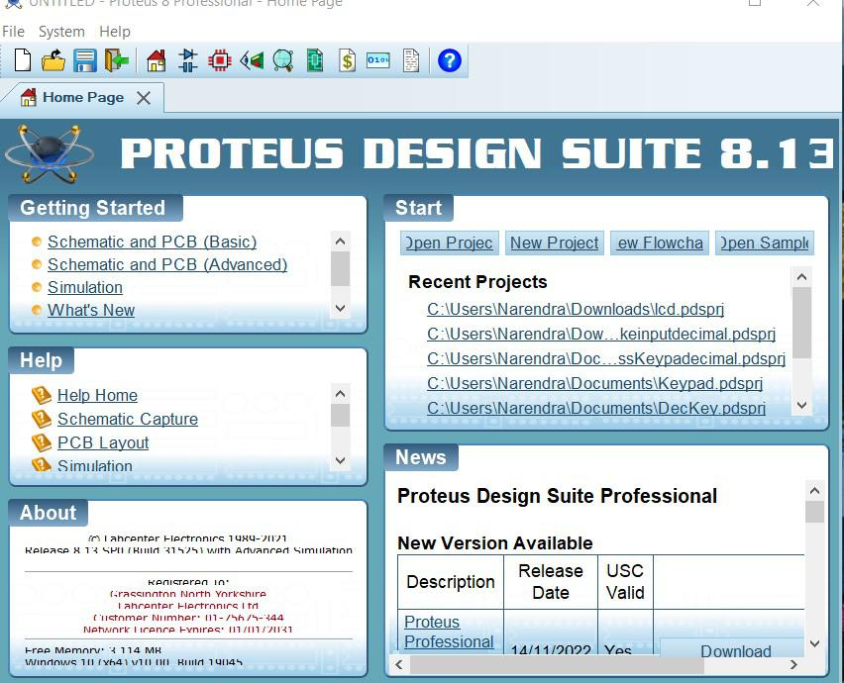

SIMULATION TOOL
Proteus 8 Professional is a powerful software tool that is widely used by electronics engineers and designers for circuit simulation, PCB layout, and firmware development.
It offers a seamless workflow from schematic capture to physical design implementation.
With its extensive component library and advanced simulation capabilities, Proteus 8 Professional allows engineers to prototype and test their designs before manufacturing.

Slide 6
ADVANTAGES
Long Range: Covers large areas without repeaters.
Low Power: Operates on low energy consumption.
Reliable: Maintains communication integrity in busy RF environments.
Real-Time Monitoring: Provides instant traffic data updates.

Slide 7
APPLICATIONS
Adaptive Traffic Light Control : Adjusts light timings based on traffic density & reduces congestion and travel time.
Emergency Vehicle Priority : Changes lights to green for approaching emergency vehicles , ensuring quick passage for emergency vehicles.
Pedestrian Safety : Adjusts light timings for safe crossing , hence reduces accidents for pedestrians.
Traffic Flow Monitoring : Collects and analyzes traffic data & provides insights for better traffic management.

